Slide 1
Research Update
11/18/22
Chris Kong

Slide 2
Goals
Thread sequences on scaffold (provided by Dek)
Mutant 1: (LKKLAKL)₃
Mutant 2: (LKKALKL)₃
Mutant 3: Penetratin (RQIKIWFQNRRMKWKK)
Mutant 4: Dek’s basic peptide (GQLKQRRAALKQRIAALKQRRAALKWQIQG)
Mutant 5: Magainin 2 23 (GIGKFLHSAKKFGKAFVGEIMNS)
Mutant 6: Dermaseptin (DPT9) 25 (GLWSKIKDAAKTAGKAALGFVNEMV)
All threading was done using optimal scoring looking for matching residues/charges.
Run threaded sequences through Rosetta

Slide 3
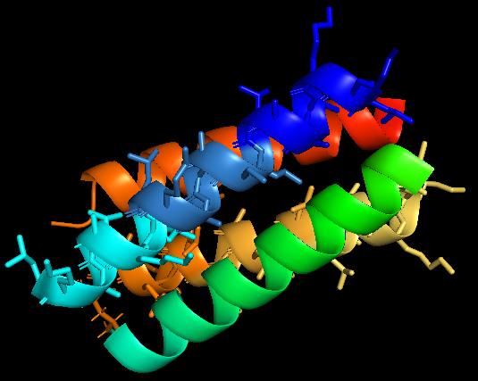
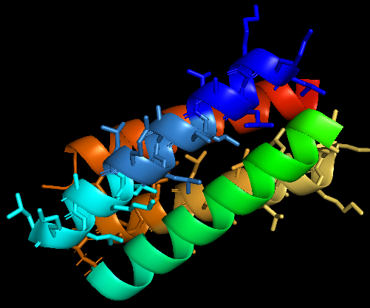
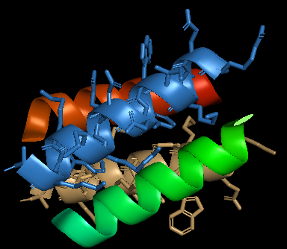
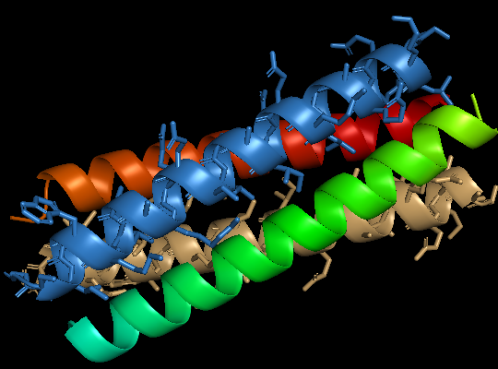
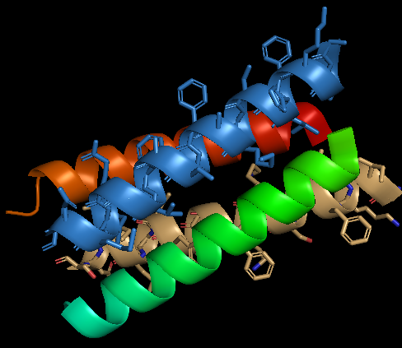
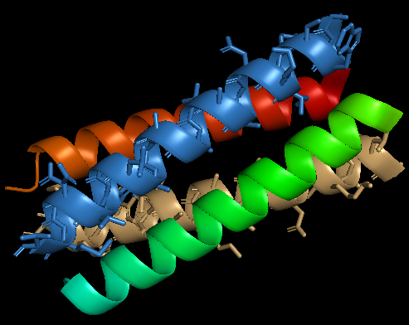
Initial Threading
See PyMOL Session: “Threading Session”
LKKLAKL
LKKALKL
Penetratin
Dek’s Basic Peptide
Magainin
Dermaseptin

Slide 4
Rosetta: Configuration
Symmetry:
Threaded sequence is unaltered
Structural sequence is allowed to change
Complex is dimer of dimers, anti-parallel symmetry of single dimer
Charge:
Desired net charge is zero. -2
The penalties are 10 for an observed charge of -10, 0 for an observed charge of -9 to -2, and 10 for an observed charge of -1. 10 0 0 10
Ramp quadratically for observed net charges of -10 or less.
Ramp quadratically for observed net charges of -10 or greater.
100 runs per mutant

Slide 5
Rosetta: Data processing
Python script: gen_fasta_csv_filter.py
Filter the top 10 pstat and total score predictions
Generate FASTA files of these predictions
Create a CSV file for further data processing
See PyMOL Session “mutants_rosetta_run01.pse”
Displays the top 10 pstat and total score predictions
Includes middle pstat and total score predictions

Slide 6
Total Score Values
 | LKKLAKL | LKKALKL | Penetratin | Dek | Magainin | Dermaseptin
Rank 1 | -294.163 | -217.539 | -96.051 | -255.552 | -206.367 | -286.747
Rank 2 | -293.147 | -216.824 | -91.539 | -247.078 | -204.909 | -285.935
Rank 3 | -291.421 | -216.588 | -91.539 | -244.758 | -203.876 | -285.791
Rank 4 | -291.019 | -216.048 | -89.887 | -242.257 | -203.576 | -283.68
Rank 5 | -290.914 | -215.171 | -89.533 | -242.005 | -203.433 | -283.309
Rank 6 | -289.802 | -214.357 | -89.194 | -241.943 | -203.149 | -282.654
Rank 7 | -287.77 | -214.257 | -88.271 | -241.411 | -203.12 | -282.231
Rank 8 | -287.153 | -214.113 | -85.802 | -237.707 | -202.48 | -282.088
Rank 9 | -287.064 | -213.679 | -85.577 | -237.423 | -202.316 | -281.594
Rank 10 | -286.497 | -213.274 | -84.925 | -237.375 | -200.994 | -281.338
Outlier 1 | -273.709 | -193.6 | -78.111 | -226.064 | -192.692 | -274.344
Outlier 2 | -279.971 |  |  |  | -192.648
*Taken from CSV file

Slide 7
Total pstat Values
 | LKKLAKL | LKKALKL | Penetratin | Dek | Magainin | Dermaseptin
Rank 1 | 0.584 | 0.499 | 0.56 | 0.531 | 0.548 | 0.639
Rank 2 | 0.581 | 0.475 | 0.544 | 0.523 | 0.543 | 0.597
Rank 3 | 0.578 | 0.466 | 0.54 | 0.491 | 0.528 | 0.597
Rank 4 | 0.568 | 0.465 | 0.533 | 0.478 | 0.527 | 0.596
Rank 5 | 0.567 | 0.462 | 0.512 | 0.474 | 0.515 | 0.595
Rank 6 | 0.565 | 0.461 | 0.508 | 0.465 | 0.515 | 0.595
Rank 7 | 0.564 | 0.457 | 0.503 | 0.463 | 0.501 | 0.593
Rank 8 | 0.562 | 0.456 | 0.501 | 0.461 | 0.5 | 0.591
Rank 9 | 0.559 | 0.455 | 0.493 | 0.459 | 0.496 | 0.587
Rank 10 | 0.555 | 0.454 | 0.491 | 0.458 | 0.496 | 0.584
Outlier 1 | 0.514 | 0.392 | 0.414 | 0.418 | 0.452 | 0.536
Outlier 2 | 0.513 |  |  |  | 0.452
*Taken from CSV file

Slide 8
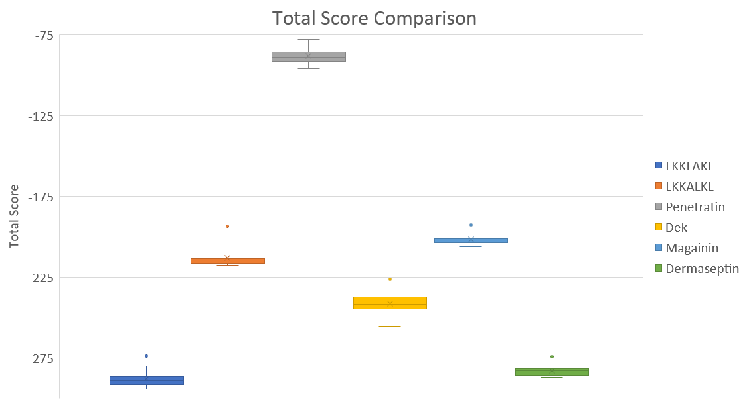

Slide 9
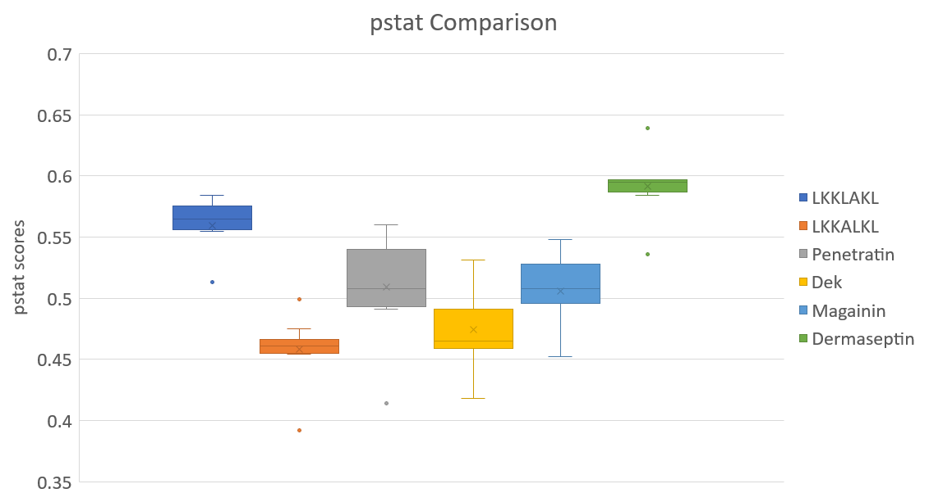

Slide 10
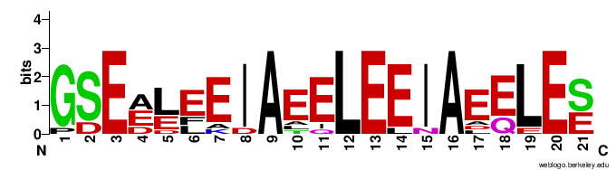

Mutant 1: (LKKLAKL)₃
Structural Helix:
pstat
Total score

Slide 11
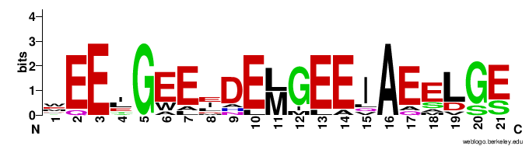
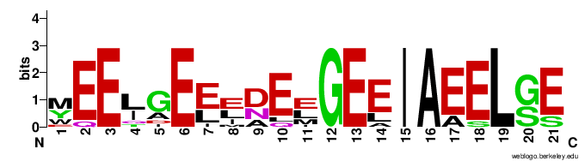
Mutant 2: (LKKALKL)₃
Structural Helix:
pstat
Total score

Slide 12
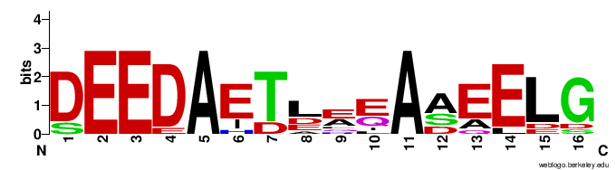
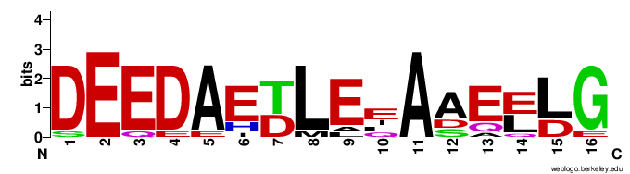
Mutant 3: Penetratin
Structural Helix:
pstat
Total score

Slide 13
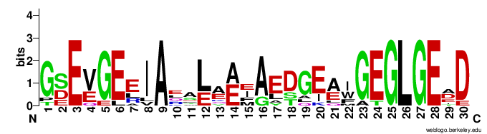
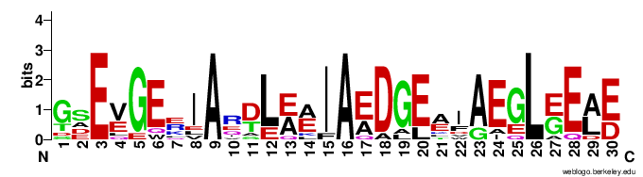
Mutant 4: Dek’s basic peptide
Structural Helix:
pstat
Total score

Slide 14
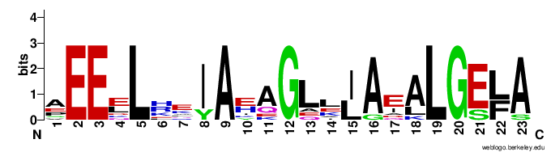
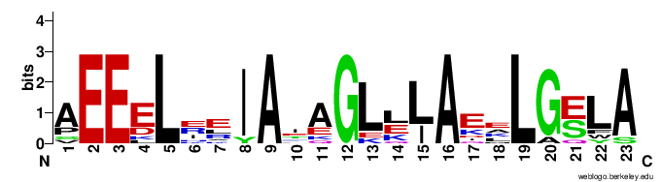
Mutant 5: Magainin
Structural Helix:
pstat
Total score

Slide 15
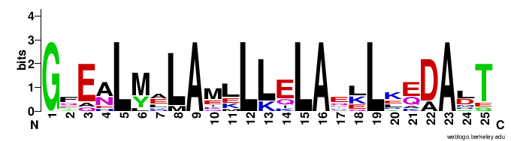
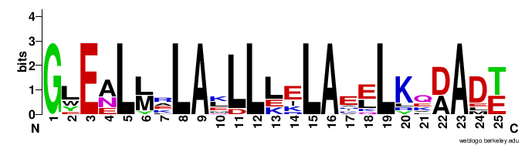
Mutant 6: Dermaseptin
Structural Helix:
pstat
Total score

Slide 16
Next Steps
Looping with GSSGSS(LPVR↓GS)GSGGSG
Running predictions through AlphaFold2/OmegaFold
Further Rosetta runs to reach consensus sequence

